Slide 1
COVID-19 Vaccines
Aggie Public Health Ambassador Program
Notes:
Hello there! My name is [APHA Name], and I am an Aggie Public Health Ambassador from the UC Davis Department of Public Health Sciences.
The Aggie Public Health Ambassadors are a group of UC Davis students who educate and encourage Davis community members on healthy behaviors like mask wearing, physical distancing, hand washing, and routine COVID testing to stay safe from COVID-19.
Today, we will be learning about the newest way to protect ourselves from COVID: (*pause*) COVID-19 vaccines.

Slide 2
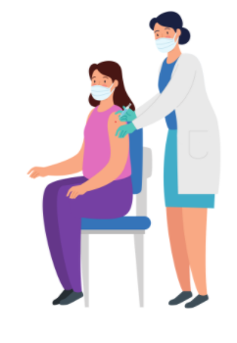
Lesson Overview
What is COVID-19?
How COVID-19 Vaccines Work
Benefits of COVID-19 Vaccines
Debunking Vaccine Myths
Vaccine Eligibility
Notes:
Here is an overview of our lesson for today.
First, I'll explain what COVID-19 is.
Then we will talk about how vaccines work.
From there, we'll discuss the benefits of vaccines for both individuals and communities.
We'll debunk some common vaccine myths.
And we will end with checking out vaccine eligibility for you and your family.

Slide 3
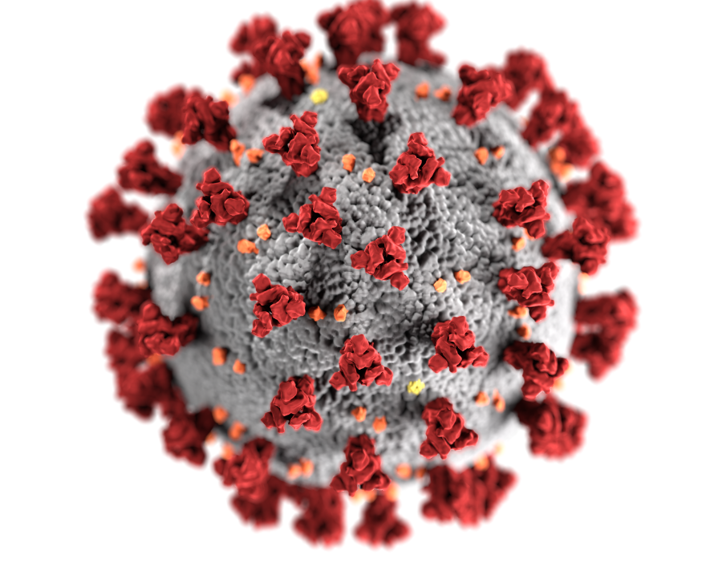
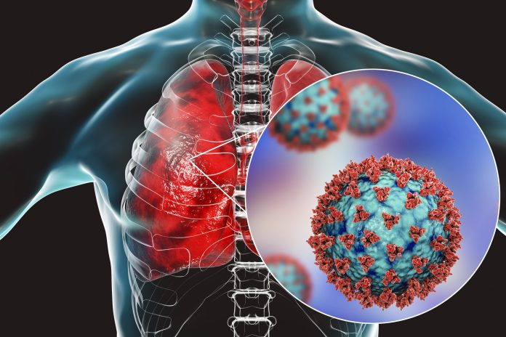
What is COVID-19?
Coronavirus (COVID-19) is an infectious respiratory disease caused by the virus SARS-CoV-2.
Coronavirus gets its name from the crown-like spike proteins on its surface.
COVID-19 can look different from person-to-person when they get sick with this disease.
The virus spreads via respiratory droplets which are produced anytime a person breathes, coughs, sneezes, or speaks.
Prevention: hand washing, mask wearing, physical distancing, regular COVID testing, symptom monitoring
Notes:
Let's start with the basics. What is COVID-19?
Coronavirus (or COVID-19) is an infectious respiratory disease that is caused by a germ (or virus) named SARS-CoV-2.
"Infectious" is just a long word that means able to spread from person-to-person.
Your respiratory system is made up of the body parts that help you breathe: everything from your nose, down through your throat, and to your lungs.
Coronavirus gets its name from the crown-like spike proteins on its surface.
Over the past year, you may have noticed that COVID-19 can look different from person-to-person when someone gets sick with this disease:
Some people might get infected but not feel sick at all.
There are folks who only experience mild, flu-like symptoms such as cough, fever, runny nose, or tiredness.
And then there are others who need to go to the hospital for difficulty breathing and other more serious symptoms.
The virus spreads via respiratory droplets (or tiny spit particles) which are made anytime a person breathes, coughs, sneezes, or speaks.
The best ways to protect yourself are washing your hands, wearing a mask, staying 6-feet apart from others, getting tested for COVID regularly, and staying home when you feel sick.
These behaviors can keep you and your social bubble (like your parents, grandparents, siblings or other people who live with you) stay healthy and safe from COVID.

Slide 4
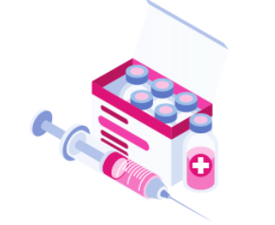
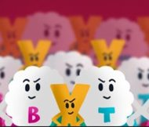
Vaccine introduced to body
Immune response launched
Antibodies able to recognize & fight real virus
How COVID-19 Vaccines Work
Notes:
In addition to these health behaviors, we now have the COVID-19 vaccines to help us stay healthy and safe.
Getting the COVID-19 vaccine is one of the most important things each of us can do to end the COVID-19 pandemic. Over the past year, scientists have been working hard to create a safe and effective COVID-19 vaccine. As vaccines are becoming more widely available, it is important to know some key facts about them.
To make you feel sick, viruses make copies of themselves to overshadow your healthy cells and take control of your body. Vaccines train our bodies to stop viruses from taking over.
So how do COVID-19 vaccines work?
As a brief overview:
You visit the doctor, and they vaccinate you.
Then, the vaccine launches an immune response. An immune response means:
Your immune system is a team of cells and molecules that protects you from getting sick.
The vaccine gives your immune system the information it needs to protect you.
This immune response produces antibodies that help your body fight the real virus if you encounter it.
We'll go into more detail in the next couple slides.

Slide 5
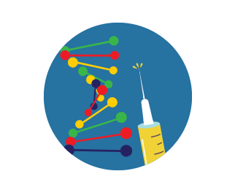
How COVID-19 Vaccines Work
Messenger RNA (mRNA) Vaccines
mRNA: genetic material with instructions to make proteins
There are two mRNA vaccines currently approved for use from Moderna and Pfizer.
COVID-19 mRNA vaccines tell our cells to produce harmless spike proteins, mimicking those on SARS-CoV-2.
The spike proteins trigger an immune response that prompts antibodies (special virus-searcher proteins) to recognize and tag these proteins that do not belong on our cells.
T-cells ("killer" immune cells) eliminate the tagged, infected cells.
The antibodies are now prepared to recognize real SARS-CoV-2 and protect us from severe infection.
Notes:
There are a couple types of COVID vaccines that are now being used to protect the population.
For many vaccines, weakened or inactivated virus is introduced to your bodies. This weakened virus mimics what the real virus would do so that your immune system can fight the real thing if you encounter it.
MRNA vaccines work a little differently.
MRNA is genetic material with protein-making instructions for our cells.
Our cells are already used to reading instructions from mRNA, and so the mRNA vaccines are a neat way to teach our immune systems how to fight COVID.
There are two mRNA vaccines currently approved to be given to people from Moderna and Pfizer, two major pharmaceutical companies.
COVID-19 mRNA vaccines tell the cells in our bodies to produce harmless spike proteins, mimicking those on SARS-CoV-2.
The spike proteins trigger an immune response that prompts antibodies (our special virus-searcher proteins) to recognize and tag these proteins that do not belong on our cells.
T-cells (our "killer" immune cells) eliminate the tagged, infected cells.
In other words, the antibodies are like sidekicks who put signals on the infected cells. These signals help the superhero immune cells easily find and get rid of the infected cells.
The two mRNA vaccines from Moderna and Pfizer come in two doses. After your second dose, you might experience side effects like fever, chills, fatigue, or body aches. These are signs that your body is building up an immune response. Side effects may last a couple days, and then it takes a couple weeks for your body to build immunity against COVID-19.
After a couple weeks, your antibodies are now prepared to recognize real SARS-CoV-2 and protect you from severe infection.

Slide 6
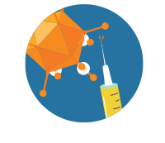
How COVID-19 Vaccines Work
Viral Vector Vaccines
Viral vector: modified, harmless version of a different virus with instructions to make proteins
There is one viral vector vaccine currently in use from Johnson & Johnson.
COVID-19 viral vector vaccines tell our immune cells to produce harmless spike proteins which triggers an immune response and activates antibodies that are now able to recognize real SARS-CoV-2 virus.
Notes:
There is also a viral vector COVID-19 vaccine.
A viral vector is a modified, harmless version of a different virus with instructions to make proteins.
There is one viral vector vaccine currently approved for use: Johnson & Johnson.
This vaccine comes in one dose instead of two.
Viral vector vaccines work in a really similar way to mRNA vaccines.
They tell our immune cells to produce harmless spike proteins, trigger an immune response, and activate antibodies that are now able to recognize real SARS-CoV-2.

Slide 7
How COVID-19 Vaccines Work
Comparing the Vaccines
 | Moderna | Pfizer | Johnson & Johnson
Type | mRNA | mRNA | Viral Vector
Number of Doses | 2 (28 days apart) | 2 (21 days apart) | 1
Efficacy | 94.1% | 95.0% | 72.0%
Notes:
This table summarizes some key points about the vaccines. Although the vaccines differ in how effective they are, all of them will protect you from COVID-19.

Slide 8
Benefits of COVID-19 Vaccines
Slows the spread of COVID-19
Creates herd immunity
Protects you from COVID-19 infection
Protects you from severe illness
Individual
Community
Population
Notes:
COVID-19 vaccines are important for your health and safety and the health and safety of people around you.
The COVID-19 vaccines benefit us on an individual level, community level, and population level.
For individuals, a vaccine protects you from COVID-19 infection and can protect you from severe illness from this disease.
On a community level, as more people are vaccinated, the spread of COVID-19 will slow down.
For the broader population, herd immunity is created once a certain proportion of people is vaccinated.

Slide 9
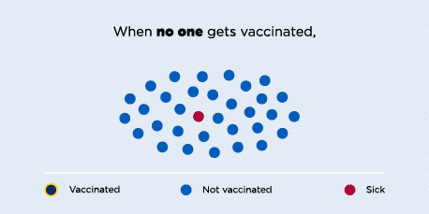
Herd Immunity
CDC Definition: a situation in which a sufficient proportion of a population is immune to an infectious disease (through vaccination and/or prior illness) to make its spread from person to person unlikely
Notes:
What exactly is herd immunity?
The Centers for Disease Control and Prevention define herd immunity as "a situation in which a sufficient proportion of a population is immune to an infectious disease (through vaccination and/or prior illness) to make its spread from person to person unlikely."
Here is a visual that should help us understand this definition a little better.
When no one gets vaccinated, the disease can spread easily.
When some people get vaccinated, the disease spreads a little slower.
When most people get vaccinated, the disease can't spread.
In other words, a certain proportion of people need to be vaccinated in order to protect the population from mass infection.

Slide 10
Herd Immunity
What proportion of the population needs to be vaccinated to achieve herd immunity for a disease?
If previously infected people might be protected from COVID, why don't we just reopen everything and see what happens?
Depends on how infectious the disease is.
Researchers are still figuring out how much of the population needs to be vaccinated to achieve COVID-19 herd immunity.
Herd immunity by infection is not ideal.
Additionally, researchers are still determining how long individuals are protected from future infection after recovering from COVID-19.
Bottom line: It is important for as many people as possible to be vaccinated.
Notes:
You might have a couple questions about herd immunity.
First off, what proportion of the population needs to be vaccinated to achieve herd immunity for a disease?
The answer really depends on how infectious the disease is or how quickly the disease can travel from person to person.
A disease like measles spreads quickly and so requires about 95% of the population to be vaccinated to achieve herd immunity.
A disease like seasonal flu might change from year to year and so there isn't a clear percentage of people who need to be vaccinated, but this is why you're encouraged to have your annual flu shot to protect yourself and your community.
For COVID-19, researchers are still figuring out how much of the population needs to be vaccinated to achieve herd immunity.
If previously infected people might be protected, why don't we just reopen everything and see what happens?
Given the severity of many COVID-19 cases, herd immunity by infection is not ideal and unsafe.
Additionally, researchers are still determining how long individuals are protected after recovering from COVID-19.
The antibodies we discussed earlier might not last as long in our bodies as for other infectious diseases.
The key takeaway from these two questions: it is important for as many people as possible to be vaccinated.

Slide 11
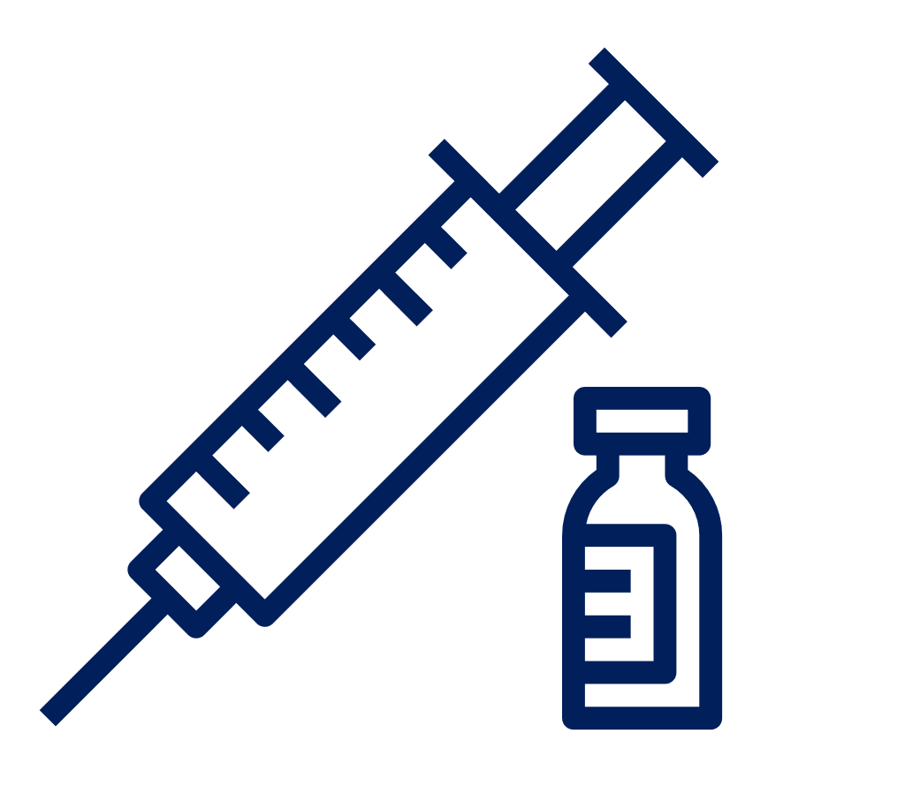
Debunking Vaccine Myths
The COVID-19 vaccines were developed really quickly. Are they safe?
Will I get infected with COVID or test positive for COVID from the vaccine?
You mentioned genetic material earlier. Will the vaccines alter my DNA?
Yes! These vaccines were tested and evaluated in tens of thousands of clinical trial participants. To be used on a mass scale, the vaccines had to meet strict safety, effectiveness, and manufacturing quality standards.
​
No, the COVID vaccines currently in use do not use live virus. You would not test positive on a viral test.
No, neither the mRNA vaccine nor the viral vector vaccine will affect your DNA. Your body gets rid of the vaccine instructions once your immune cells are activated.
Notes:
Let's talk about some other questions you might have about the vaccines.
The COVID-19 vaccines were developed really quickly. Are they safe?
Yes! These vaccines were tested and evaluated in tens of thousands of clinical trial participants.
To be used on a mass scale, the vaccines had to meet strict safety, effectiveness, and manufacturing quality standards.
Will I get infected with COVID or test positive for COVID from the vaccine?
No, the COVID vaccines currently in use do not use live virus. You would not test positive on a viral test.
You mentioned genetic material earlier. Will the vaccines alter my DNA?
No, neither the mRNA vaccine nor the viral vector vaccine will affect your DNA. Your body gets rid of the vaccine instructions once your immune cells are activated.

Slide 12
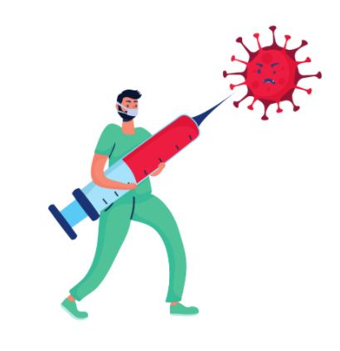
Debunking Vaccine Myths
Should I still get vaccinated if I've already had COVID-19?
Once I'm vaccinated, can I stop wearing my mask? Should I still get COVID-tested regularly?
Yes! It is important to be vaccinated, even if you've previously had COVID.
As we discussed earlier, we still do not know how long you are protected from COVID after recovering from it.¹⁰
Before and even after vaccination, it will be essential for everyone to continue to get tested regularly, wear face coverings, maintain physical distance and practice good hand hygiene to help continue to keep our community healthy.
Notes:
Should I still get vaccinated if I've already had COVID-19?
Yes! It is important to be vaccinated, even if you've previously had COVID-19.
As we discussed earlier, we still do not know how long you are protected from COVID-19 after recovering from it.
Once I'm vaccinated, can I stop wearing my mask? Should I still get COVID-19-tested regularly?
Before and even after vaccination, it will be essential for everyone to continue to get tested regularly, wear face coverings, maintain physical distance and practice good hand hygiene to help continue to keep our community healthy.
So even though we might be eager to get back to "normal" life, we still need be cautious and keep ourselves and our community safe with these preventative health behaviors.

Slide 13
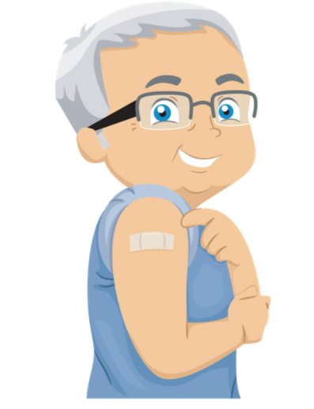
Check Out Your Vaccine Eligibility
In California, the vaccine has been distributed to the following groups:
Phase 1A: Healthcare workers & long-term care residents
Phase 1B: People 65+ years old. People working in Agriculture/Food, Education/Childcare, Emergency Services
Appointments are now open for High-Risk 16+ years old individuals.
April 1, 2021: Individuals 50+ years old.
April 15, 2021: Everyone 16+ years old.
California Department of Public Health MyTurn Site: https://myturn.ca.gov/
Notes:
You might have already discussed getting vaccinated with your parents, grandparents, or other family members.
There is a schedule of when people are allowed to get the vaccine.
In California, priority was first given to the following groups:
Phase 1A included healthcare workers & long-term care residents.
Phase 1B includes people 65+ years old and people working in Agriculture/Food, Education/Childcare, Emergency Services
Appointments are now open for High-Risk 16+ years old individuals.
As of April 1, 2021, Individuals who are 50 years old and older are able to get vaccinated.
As of April 15, 2021: Everyone who are 16 years old and older are able to get vaccinated.
We encourage you to check out the California Department of Public Health MyTurn site at myturn.ca.gov to determine your or a family member's eligibility, find a local clinic, and make a vaccine appointment.

Slide 14
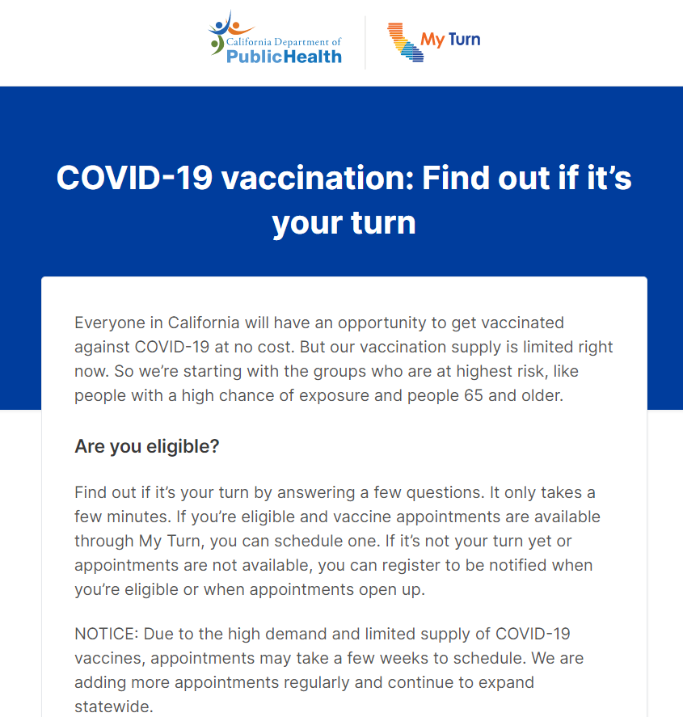
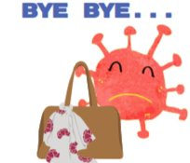
Check Out Your Vaccine Eligibility
California Department of Public Health MyTurn Site: https://myturn.ca.gov/
Notes:
Here is a screenshot of the MyTurn site.
You can select the website language on this first page.
From there, you answer questions about the different eligibility criteria and then type in your zip code.
The site will then tell you if it's your turn to get vaccinated.
If you are eligible to be vaccinated, you can select from many vaccine clinics.
Check it out with your family to find appointments near you!

Slide 15
References
CDC. Coronavirus Disease 2019 (COVID-19). Centers for Disease Control and Prevention. Published February 11, 2020. Accessed March 24, 2021. https://www.cdc.gov/coronavirus/2019-ncov/cdcresponse/about-COVID-19.html
CDC. COVID-19 and Your Health: How COVID-19 Spreads. Centers for Disease Control and Prevention. Published October 28, 2020. Accessed March 23, 2021. https://www.cdc.gov/coronavirus/2019-ncov/prevent-getting-sick/how-covid-spreads.html
CDC. Understanding mRNA COVID-19 Vaccines. Centers for Disease Control and Prevention. Published March 4, 2021. Accessed March 24, 2021. https://www.cdc.gov/coronavirus/2019-ncov/vaccines/different-vaccines/mrna.html
COVID-19 Vaccines: Infographic | Johns Hopkins Medicine. Accessed March 24, 2021. https://www.hopkinsmedicine.org/health/conditions-and-diseases/coronavirus/coronavirus-vaccines-infographic
CDC. Understanding Viral Vector COVID-19 Vaccines. Centers for Disease Control and Prevention. Published March 2, 2021. Accessed March 24, 2021. https://www.cdc.gov/coronavirus/2019-ncov/vaccines/different-vaccines/viralvector.html
Comparing the COVID-19 Vaccines: How Are They Different? Yale Medicine. Accessed March 29, 2021. https://www.yalemedicine.org/news/covid-19-vaccine-comparison
Vaccine Glossary of Terms | CDC. Published July 31, 2020. Accessed March 29, 2021. https://www.cdc.gov/vaccines/terms/glossary.html
Linka K, Peirlinck M, Kuhl E. The reproduction number of COVID-19 and its correlation with public health interventions. medRxiv. Published online July 7, 2020. doi:10.1101/2020.05.01.20088047.
CDC. COVID-19 and Your Health: Safety of COVID-19 Vaccines. Centers for Disease Control and Prevention. Published February 11, 2020. Accessed March 29, 2021. https://www.cdc.gov/coronavirus/2019-ncov/vaccines/safety/safety-of-vaccines.html
CDC. COVID-19 Vaccine Facts. Centers for Disease Control and Prevention. Published March 11, 2021. Accessed March 22, 2021. https://www.cdc.gov/coronavirus/2019-ncov/vaccines/facts.html
California S of. Vaccines. Accessed March 29, 2021. https://covid19.ca.gov/vaccines/
Notes:
Here is a list of the references we used to write these slides. Remember that it is very important to choose sources with a critical eye and from reputable sources to find the most accurate information.

Slide 16
Thank You!
More Information: campusready.ucdavis.edu
Notes:
Thank you for watching this presentation! We hope you had fun learning about vaccines with us. Stay healthy and safe!

