Slide 1
COVID-19 Vaccines
Aggie Public Health Ambassador Program
Notes:
Hello there! My name is [APHA Name], and I am an Aggie Public Health Ambassador from UC Davis.
Aggie Public Health Ambassadors are UC Davis college students who teach people in Davis about how to stop the spread of COVID-19 and keep our community safe.
Today, we will be learning about the newest way to protect ourselves from COVID: (*pause*) COVID-19 vaccines.

Slide 2
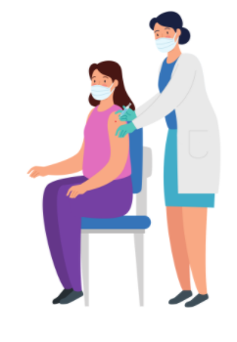
Lesson Overview
What is COVID-19?
How COVID-19 Vaccines Work
Benefits of COVID-19 Vaccines
Debunking Vaccine Myths
Vaccine Eligibility
Notes:
Here is an overview of our lesson for today.
First, I'll explain what COVID-19 is.
Then we will talk about how vaccines work.
From there, we'll discuss the benefits of vaccines for both a person and a group of people.
We'll help you learn how not to be tricked by some vaccine myths.
And we will end with sharing how you and your family can get the vaccine.

Slide 3
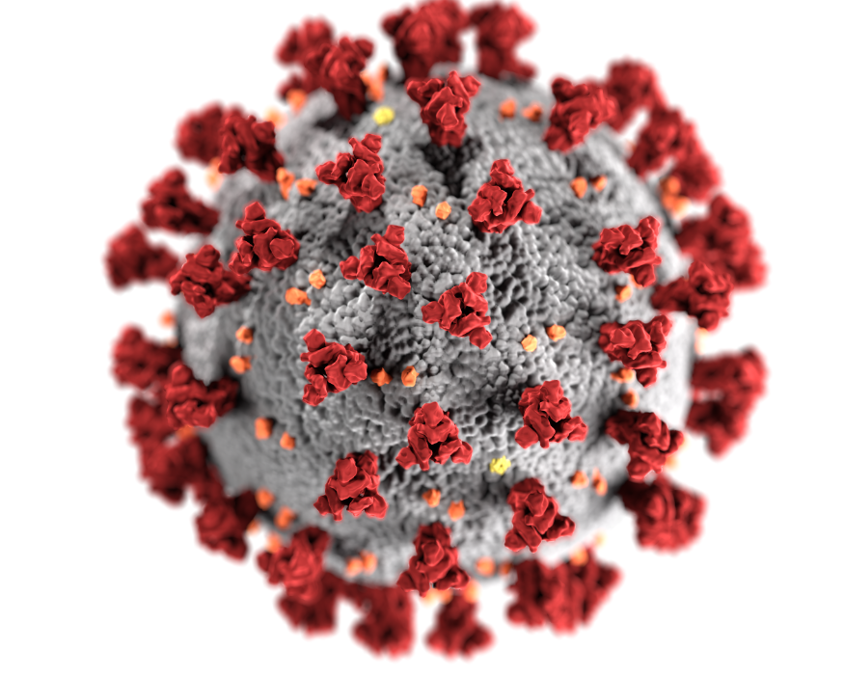
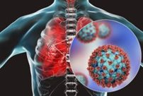
What is COVID-19?
Introduction
Coronavirus (COVID-19): infectious respiratory disease
SARS-CoV-2: virus (germ) that causes COVID-19
Coronavirus gets its name from the crown-like spike proteins on its surface.
COVID-19 can look different from person to person when they get sick with this disease.
Notes:
Let's start with the basics. What is COVID-19?
Coronavirus (or COVID-19) is an infectious respiratory disease that is caused by a germ (or virus) named SARS-CoV-2.
"Infectious" is just a long word that means able to spread from person-to-person.
Your respiratory system is made up of the body parts that help you breathe: everything from your nose, down through your throat, and to your lungs.
Coronavirus gets its name from the crown-like spike proteins on its surface.
COVID-19 can look different for different people when they get sick with this disease:
Some people might get infected but not feel sick at all.
Some only experience mild, flu-like symptoms such as cough, fever, runny nose, or tiredness.
And then there are others who need to go to the hospital for difficulty breathing and other more serious problems.

Slide 4
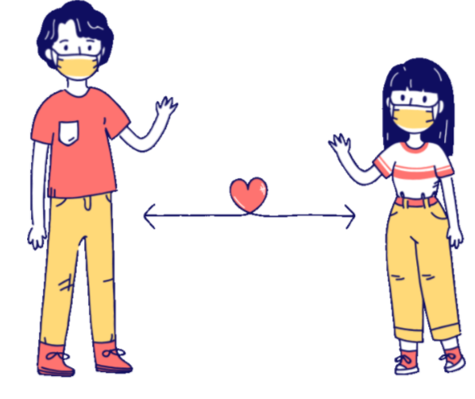
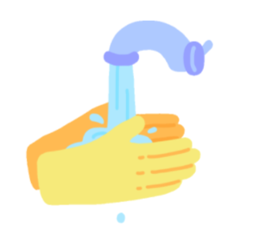
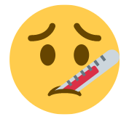
What is COVID-19?
Staying Healthy & Safe
The virus spreads via respiratory droplets which are made anytime a person breathes, coughs, sneezes, or speaks.
Prevention: hand washing, mask wearing, physical distancing, regular COVID testing, and symptom monitoring
Notes:
How can we stay healthy and safe from COVID-19?
The virus spreads via respiratory droplets (or tiny spit particles) which are made anytime a person breathes, coughs, sneezes, or speaks.
The best ways to protect yourself are washing your hands, wearing a mask, staying 6-feet apart from others, getting tested for COVID-19 regularly, and staying home when you feel sick.
These behaviors can keep you and your social bubble (like your parents, grandparents, siblings or other people who live with you) healthy and safe from COVID-19.

Slide 5
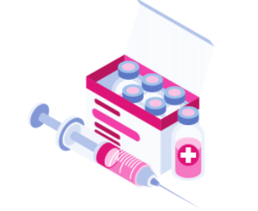
Vaccine introduced to body
Immune response launched
Antibodies able to recognize & fight real virus
How COVID-19 Vaccines Work
Notes:
In addition to these health behaviors, we now have the COVID-19 vaccines to help us stay healthy and safe.
Getting the COVID-19 vaccine is one of the most important things each of us can do to end the COVID-19 pandemic. Your families and loved ones may have started talking about the COVID-19 vaccines recently, and you might have some questions too.
In the first place, how do COVID-19 vaccines work?
Here's the short answer:
You visit the doctor, and they give you a shot.
Then, the vaccine guides your body on how to protect you.
Your body then makes antibodies that are able to kill the real virus if you get it.
I'll explain some of the meanings of these vaccine words on the next few slides.

Slide 6
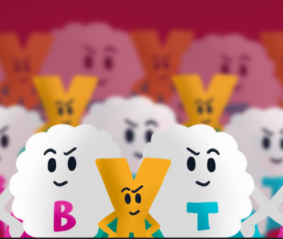
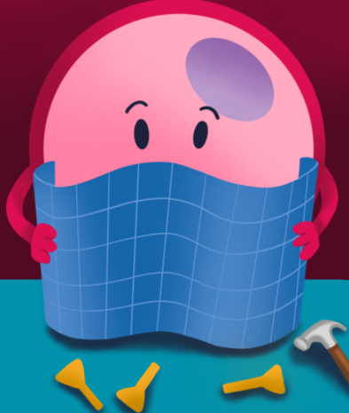
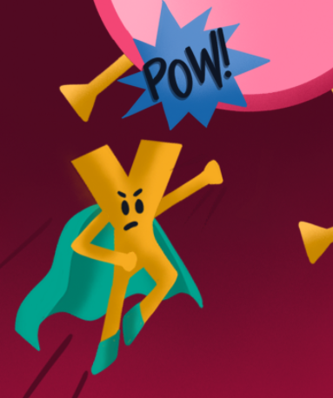
How COVID-19 Vaccines Work
Vaccines & Your Immune System
Immune System: Superhero cells and molecules in your body that protect you from getting sick.
Vaccines: Train your immune cells to recognize the germs that make you sick.
After you are vaccinated, your immune cells are ready to fight the germs away!
Notes:
Vaccines and Your Immune System.
Inside our bodies, we all have cells and molecules that make sure that everything is working correctly so that we can breathe, eat, move, sleep, and think properly.
To make you feel sick, viruses copy themselves and attack your healthy cells, trying to take control of your body.
Your immune system is made up of superhero cells and molecules in your body that protect you from getting sick.
It is difficult for your immune system to protect you from germs that it hasn't prepared for yet.
This is where vaccines can help. Vaccines are really important because they train your immune system to recognize the germs that make you sick. Then, the cells fight the virus (after they have had practice).
After you're vaccinated, your immune cells are ready to fight the germs away!

Slide 7
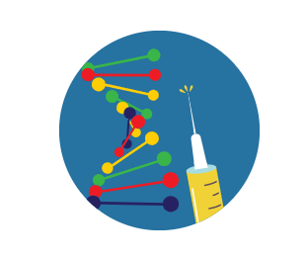
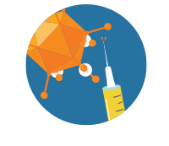
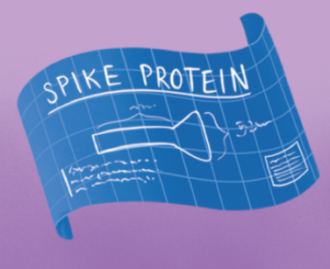
Both types of vaccines give our cells instructions to make harmless spike proteins that mimic those found on coronavirus.
Once cells are covered in spike proteins, antibodies (special virus-searchers) mark these infected cells.
More immune cells come in as back-up to eliminate the marked, infected cells.
Your immune system is now ready to fight the
real coronavirus!
How COVID-19 Vaccines Work
Vaccines & Your Immune System
Vaccine Types
mRNA
Viral vector
Notes:
So how do vaccines train our immune cells to fight the virus?
Right now, there are two types of vaccines that work in similar ways: mRNA vaccines and viral vector vaccines.
mRNA is basically a messenger molecule that can carry protein-making instructions to the cells in your body.
Viral vectors also carry instructions for making proteins, but in the form of harmless versions of a different, non-COVID-19 virus.
Both types of vaccines give our cells instructions to make harmless spike proteins that look like those found on coronavirus. These will serve as target practice.
Once these “target practice” cells are covered in spike proteins (or crowns), antibodies (or special virus-searchers) mark these infected cells.
More immune cells come in as back-up to eliminate the marked, infected cells.
In other words, the antibodies are like the sidekicks who put signals on the infected cells. These signals help the superhero immune cells easily find and kill the infected cells.
After you're vaccinated, you might be tired or feel side effects like fever, chills or body aches. These are signs that your immune cell team is training and building up protection for you. Side effects may last a couple days, and then it takes a couple weeks for your body to build immunity against COVID-19.
After a couple weeks, your immune system is now ready to fight the real virus!

Slide 8
Benefits of COVID-19 Vaccines
Slows the spread of COVID-19
Creates herd immunity
Protects you from COVID-19 infection
Protects you from becoming very sick
Individual
Community
Population
Notes:
COVID-19 vaccines are important for your health and safety and the health and safety of people around you.
For individuals, a vaccine protects you from COVID-19 infection and can protect you from becoming very sick.
On a community level, as your family, friends, and neighbors are vaccinated here in Davis, the spread of COVID-19 will slow down.
Besides your family and friends and the Davis community, once many people are vaccinated all over California, the U.S., and across the world, there will be hardly anywhere where the virus could live. This is herd immunity.

Slide 9
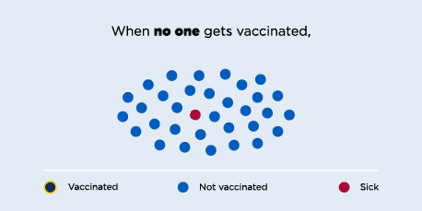
Herd Immunity
Definition: when a group of people is protected from a disease because most of the group has already been sick or vaccinated
Notes:
What exactly is herd immunity?
A simple definition of herd immunity is this: "when a group of people is protected from a disease because most of the group has already been sick or vaccinated."
Here is a visual that should help us understand this definition a little better.
When no one gets vaccinated, the disease can spread easily.
When some people get vaccinated, the disease spreads a little slower.
When most people get vaccinated, the disease can't spread.
In other words, a certain number of people need to be vaccinated in order to protect the population from mass infection.

Slide 10
Herd Immunity
How many people need to be vaccinated to achieve herd immunity for a disease?
Why don't we just reopen all public places and let everyone get sick to achieve herd immunity?
Depends on how quickly the disease can travel from person to person.
Researchers are still figuring out how much of the population needs to be vaccinated to achieve COVID-19 herd immunity.
Herd immunity by infection is not ideal.
COVID-19 antibody protection might not last for a long time.
Bottom line: It is important for as many people as possible to be vaccinated.
Notes:
You might have a couple questions about herd immunity.
First off, how many people need to be vaccinated to achieve herd immunity for a disease?
The answer really depends on how quickly the disease can travel from person to person.
A disease like measles spreads quickly. That means it requires about 95% of people to be vaccinated to achieve herd immunity.
A disease like seasonal flu might change from year to year and so we do not know exactly how many people need to be vaccinated. This is why we want everyone to have an annual flu shot. This will protect you, your family and friends, and your community.
For COVID-19, research is helping us to learn how many people need to be vaccinated to achieve herd immunity.
Remember becoming sick or getting vaccinated are ways to reach herd immunity.
Why don't we just reopen all public places and let everyone get sick to achieve herd immunity?
Given how seriously sick some people can become from COVID-19, herd immunity by infection is unsafe.
When you get sick with COVID-19 and recover from it, your body can mark and identify COVID-19-infected cells for the immune cell superheroes to fight them.
However, researchers are still figuring out how long your body can fight COVID-19 after you recover from COVID-19 *pause* (if you get sick).
The important thing to remember is: it is important for as many people as possible to be vaccinated.

Slide 11
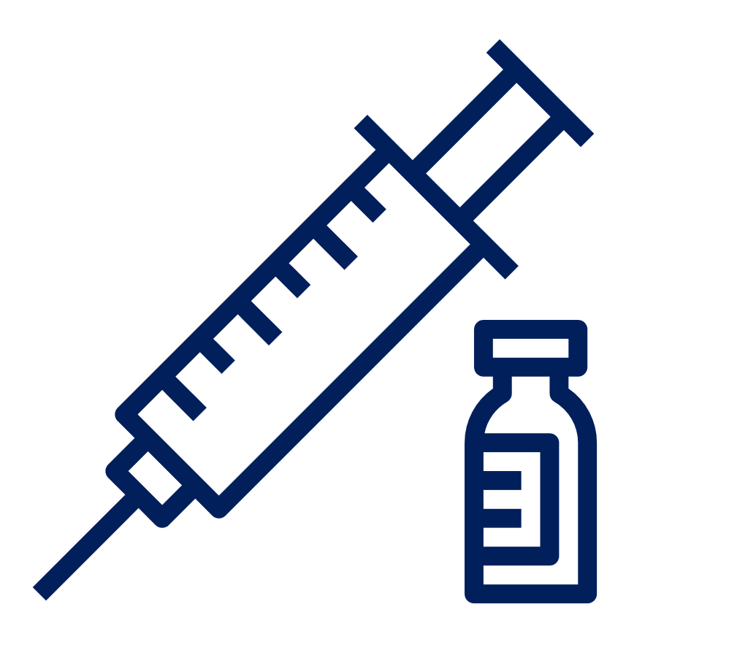
Debunking Vaccine Myths
The COVID-19 vaccines were developed really quickly. Are they safe?
Will I get infected with COVID or test positive for COVID from the vaccine?
Yes! These vaccines were tested and evaluated in tens of thousands of people who volunteered to be part of the research to test them.
To be used all over the world, the vaccines had to meet strict safety, effectiveness, and quality standards.
​
No, the COVID vaccines currently in use do not use live virus. You would not test positive since there is no virus inside of you when you get a shot.
Notes:
Let's talk about some questions you might have about the vaccines.
The COVID-19 vaccines were developed really quickly. Are they safe?
Yes! These vaccines were tested and evaluated in tens of thousands of people who volunteered to be part of the research to test them. To be used all over the world, the vaccines had to meet strict safety, effectiveness, and quality standards.
Will I get infected with COVID-19 or test positive for COVID-19 from the vaccine?
No, the COVID-19 vaccines currently in use do not use live virus. You would not test positive since there is no virus inside of you when you get a shot.

Slide 12
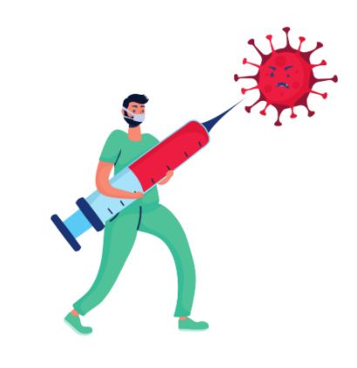
Debunking Vaccine Myths
Should I still get vaccinated if I've already had COVID-19?
Once I'm vaccinated, can I stop wearing my mask? Should I still get COVID-tested regularly?
Yes! It is important to be vaccinated, even if you've had COVID before.
As we discussed earlier, we still do not know how long you are protected from COVID after recovering from it.
Before and even after vaccination, it will be essential for everyone to continue to get tested regularly, wear face coverings, maintain physical distance and practice good hand hygiene to help continue to keep our community healthy.
Notes:
Should I still get vaccinated if I've already had COVID-19?
Yes! It is important to be vaccinated, even if you've had COVID-19 before.
As we discussed earlier, we still do not know how long you are protected from COVID-19 after recovering from it.
Once I'm vaccinated, can I stop wearing my mask? Should I still get tested regularly for COVID-19?
Before and even after vaccination, it is really important for everyone to continue to get tested regularly, wear face coverings, keep physical distance and keep your hands clean to help continue to keep our community healthy.
So even though we might be eager to get back to "normal" life, we still need be cautious and keep ourselves and our community safe.

Slide 13
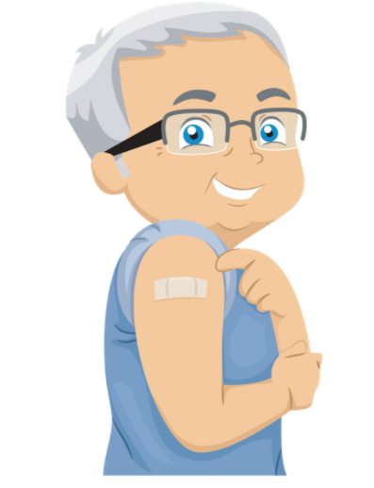
Check Out Your Vaccine Eligibility
In California, the vaccine has been distributed to the following groups:
Phase 1A: Healthcare workers & long-term care residents
Phase 1B: People 65+ years old. People working in Agriculture/Food, Education/Childcare, Emergency Services
Appointments are now open for High-Risk 16+ years old individuals.
April 1, 2021: Individuals 50+ years old.
April 15, 2021: Everyone 16+ years old.
California Department of Public Health MyTurn Site: https://myturn.ca.gov/
Notes:
Over the past couple months, you've probably heard your parents, grandparents, aunts, and uncles making vaccine appointments.
There is a schedule of when people are allowed to get the vaccine.
In California, priority was first given to the following groups:
Phase 1A included healthcare workers & long-term care residents.
Phase 1B includes people 65+ years old and people working in Agriculture/Food, Education/Childcare, Emergency Services
Appointments are now open for High-Risk 16+ years old individuals.
As of April 1, 2021, Individuals who are 50 years old and older are able to get vaccinated.
As of April 15, 2021: Everyone who are 16 years old and older are able to get vaccinated.

Slide 14
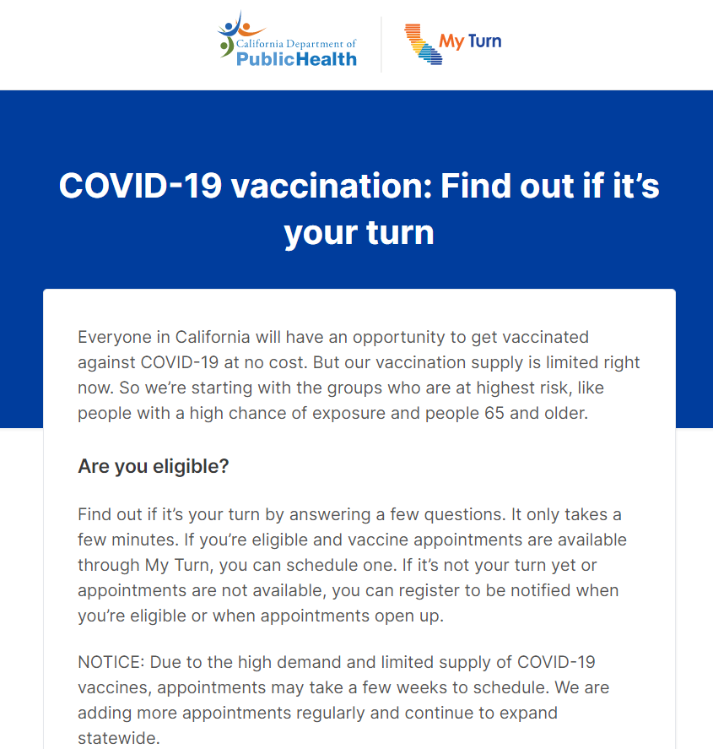
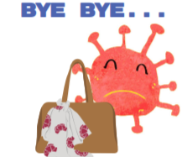
Check Out Your Vaccine Eligibility
California Department of Public Health MyTurn Site: https://myturn.ca.gov/
Notes:
Here is a screenshot of the MyTurn site.
You can select the website language on this first page.
From there, you answer questions about the different eligibility criteria and then type in your zip code.
The site will then tell you if it's your turn to get vaccinated.
If you are eligible to be vaccinated, you can select from many vaccine clinics.
Check it out with your family to find appointments near you!

Slide 15
References
CDC. Coronavirus Disease 2019 (COVID-19). Centers for Disease Control and Prevention. Published February 11, 2020. Accessed March 24, 2021. https://www.cdc.gov/coronavirus/2019-ncov/cdcresponse/about-COVID-19.html
CDC. COVID-19 and Your Health: How COVID-19 Spreads. Centers for Disease Control and Prevention. Published October 28, 2020. Accessed March 23, 2021. https://www.cdc.gov/coronavirus/2019-ncov/prevent-getting-sick/how-covid-spreads.html
CDC. Understanding mRNA COVID-19 Vaccines. Centers for Disease Control and Prevention. Published March 4, 2021. Accessed March 24, 2021. https://www.cdc.gov/coronavirus/2019-ncov/vaccines/different-vaccines/mrna.html
COVID-19 Vaccines: Infographic | Johns Hopkins Medicine. Accessed March 24, 2021. https://www.hopkinsmedicine.org/health/conditions-and-diseases/coronavirus/coronavirus-vaccines-infographic
CDC. Understanding Viral Vector COVID-19 Vaccines. Centers for Disease Control and Prevention. Published March 2, 2021. Accessed March 24, 2021. https://www.cdc.gov/coronavirus/2019-ncov/vaccines/different-vaccines/viralvector.html
Vaccine Glossary of Terms | CDC. Published July 31, 2020. Accessed March 29, 2021. https://www.cdc.gov/vaccines/terms/glossary.html
Linka K, Peirlinck M, Kuhl E. The reproduction number of COVID-19 and its correlation with public health interventions. medRxiv. Published online July 7, 2020. doi:10.1101/2020.05.01.20088047.
CDC. COVID-19 and Your Health: Safety of COVID-19 Vaccines. Centers for Disease Control and Prevention. Published February 11, 2020. Accessed March 29, 2021. https://www.cdc.gov/coronavirus/2019-ncov/vaccines/safety/safety-of-vaccines.html
CDC. COVID-19 Vaccine Facts. Centers for Disease Control and Prevention. Published March 11, 2021. Accessed March 22, 2021. https://www.cdc.gov/coronavirus/2019-ncov/vaccines/facts.html
California S of. Vaccines. Accessed March 29, 2021. https://covid19.ca.gov/vaccines/
Notes:
Here is a list of the references we used to write these slides. Remember that it is very important to do research carefully and to get information from experts so that you know what you are learning and reading is true.

Slide 16
Thank You!
More Information: campusready.ucdavis.edu
Notes:
Thank you for watching this presentation! We hope you had fun learning about vaccines with us. Stay healthy and safe!

